Slide 1


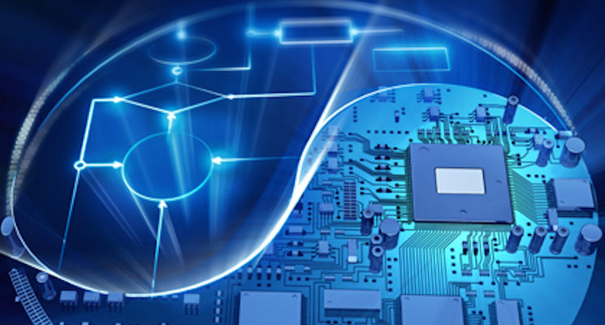
Introduction to SDC Hardware & Software

Slide 2
Overview
Hardware
Hardware parts on an actual SDC
Programable Components
Non-Programable Components
Software
Robot Operating System (ROS)
NVIDIA Jetpack
Arduino IDE
OpenCV
Tensorflow
TensorRT

Slide 3
Overview
Hardware
Hardware parts on an actual SDC
Programable Components
Non-Programable Components
Software
Robot Operating System (ROS)
NVIDIA Jetpack
Arduino IDE
OpenCV
Tensorflow
TensorRT

Slide 4
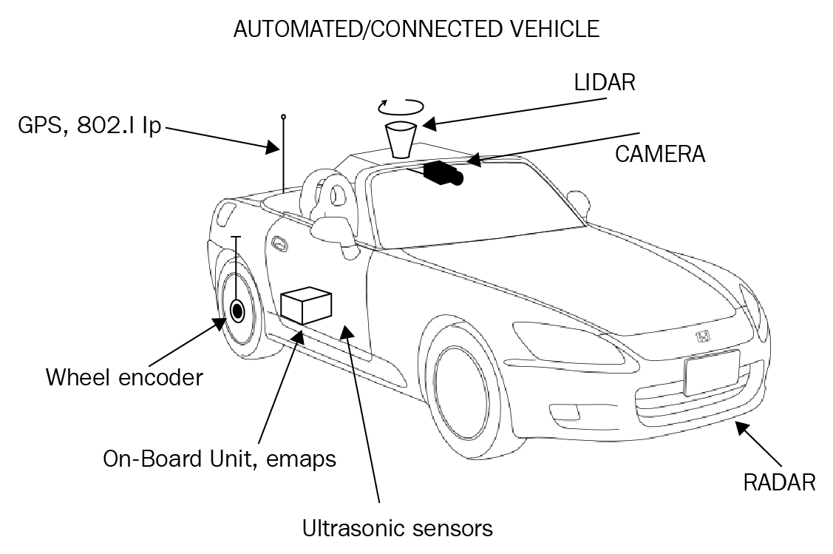
Overview
Hardware parts on an actual SDC

Slide 5
Overview
Device Name | Description | Market Example
LiDAR | Used to detect surroundings using light imaging | OPAL-P1000
Ultrasonic Sensor | Used on side-ways to detect any objects from both sides | BOSCH Ultrasonic Sensor
Camera | Used for all deep learning-based image processing | BOSCH MPC3
Wheel Encoder | For the distance covered by the wheels | Zltech
On-Board CPU | Processing services for the car | Nvidia Driver AGX Orin
Radar | Use radio waves to detect objects in way. | URAD Automotive FMCW
GPS | Map service and global localization | Clacion Fx450

Slide 6
Overview
NVIDIA Jetson Nano
Arduino
Hardware
Parts on an actual SDC
Programable Components
Non-Programable Components
Software
Robot Operating System (ROS)
NVIDIA Jetpack
Arduino IDE
OpenCV
Tensorflow
TensorRT

Slide 7
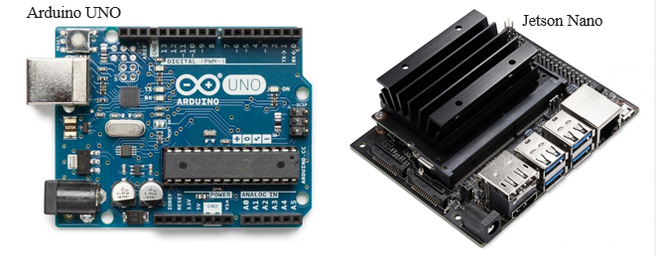
Overview
Main Processing Units (Brain of the SDC)

Slide 8
Overview
Body Chases + Wheels
Batteries
Motors + Encoders
Monster Motor Driver Shield
Voltage Regulators
Intel RealSense T265
OpenCV AI Kit
Hardware
Parts on an actual SDC
Programable Components
Non-Programable Components
Software
Robot Operating System (ROS)
NVIDIA Jetpack
Arduino IDE
OpenCV
Tensorflow
TensorRT

Slide 9
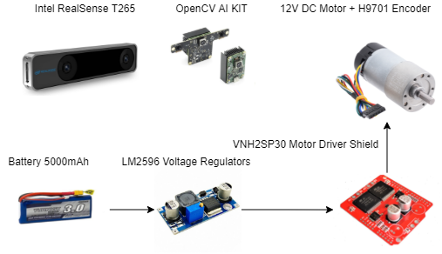
Overview
Hardware (Non-Programable)

Slide 10
Overview
Robot Operating System (ROS)
Gazebo
NVIDIA Jetpack
Arduino IDE
OpenCV
Tensorflow
TensorRT
Hardware
Parts on an actual SDC
Programable Components
Non-Programable Components
Software
Robot Operating System (ROS)
NVIDIA Jetpack
Arduino IDE
OpenCV
Tensorflow
TensorRT

Slide 11
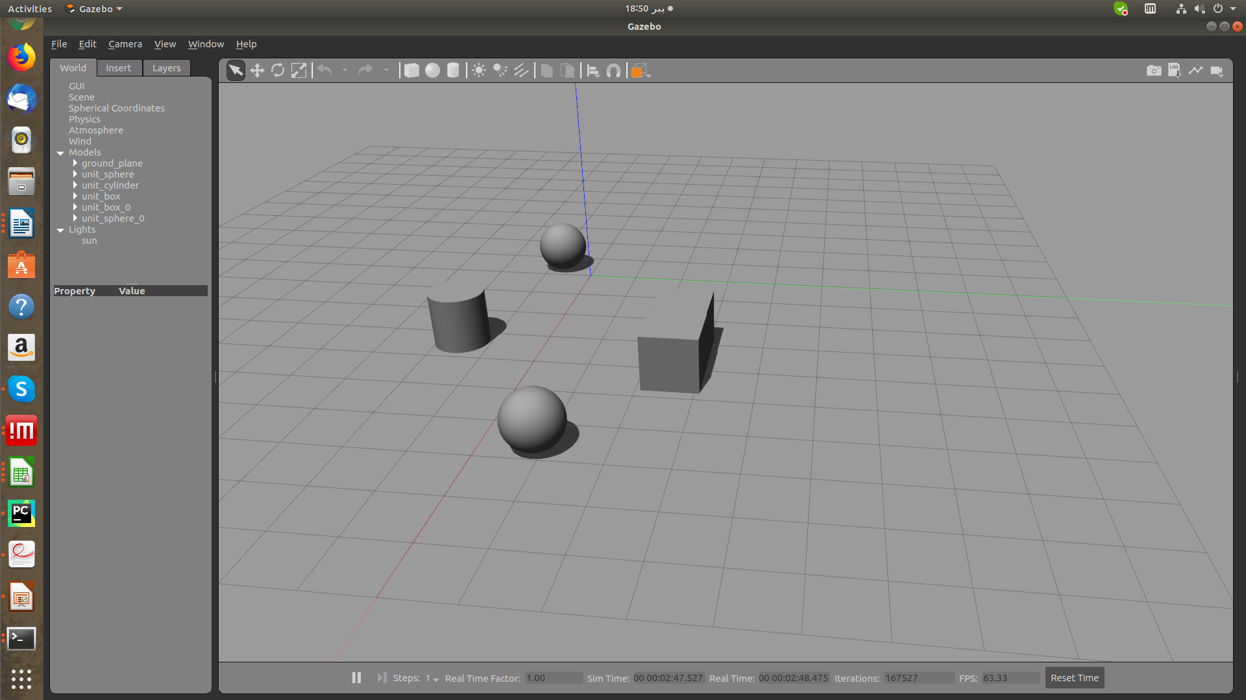
Overview
A simulator for simulation of desired robot activities in a self-defined 3D space.
Gazebo is the 3D space simulator tool.
Robot Operating System (ROS)

Slide 12
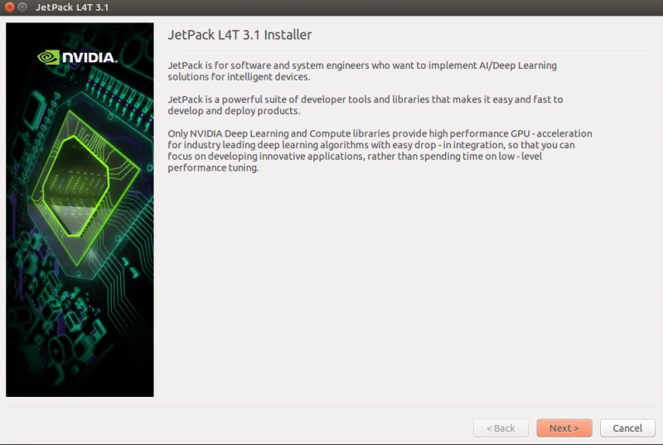
Overview
Ubuntu based OS for NVIDIA Jetson Nano
Make the Jetson Nano a micro computer to perform the major processing
NVIDIA Jetpack

Slide 13
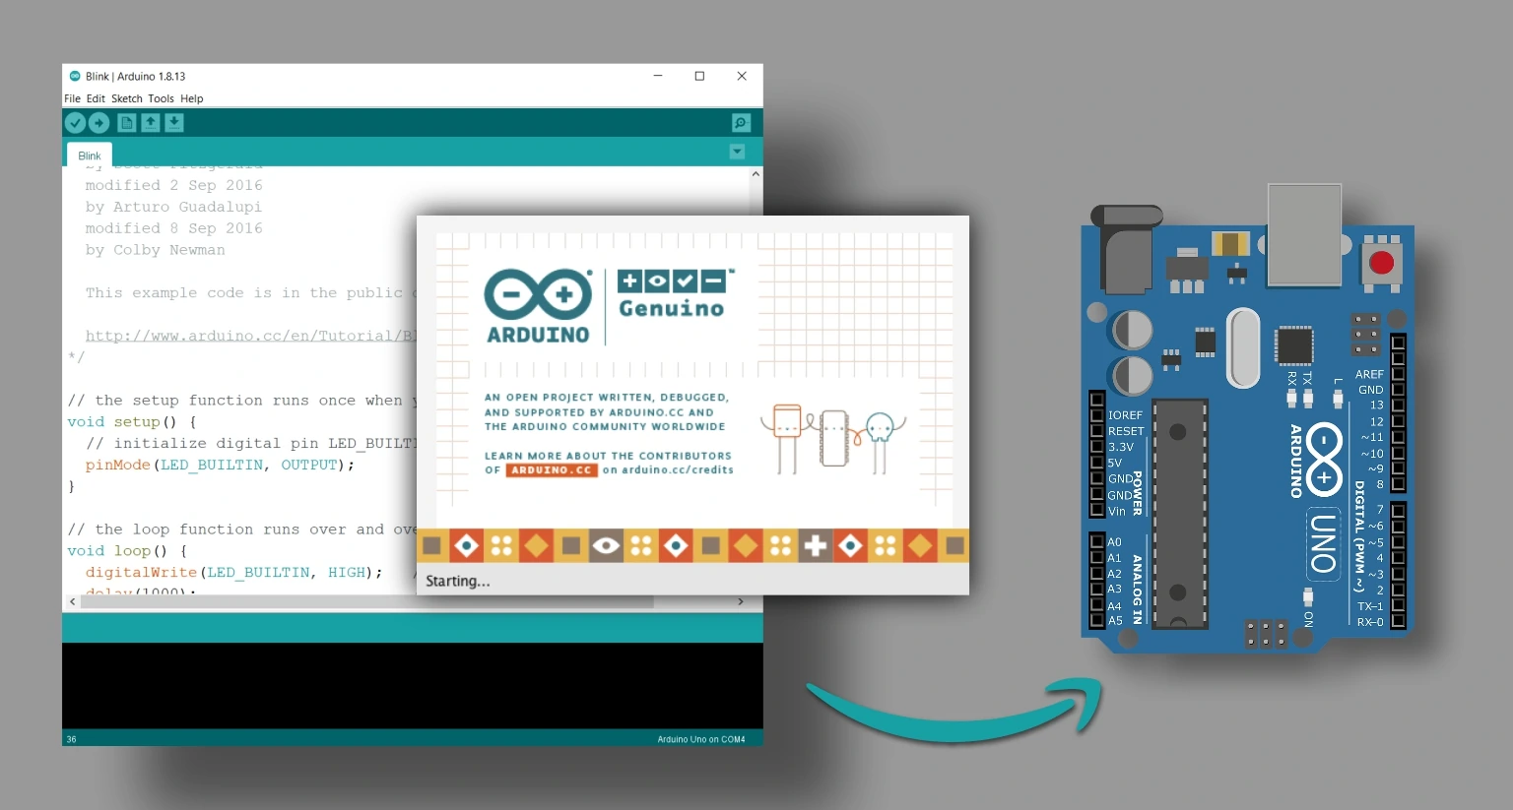
Overview
IDE for Arduino
Maneuvering hardware is controlled by the instruction code using this program
Arduino IDE

Slide 14
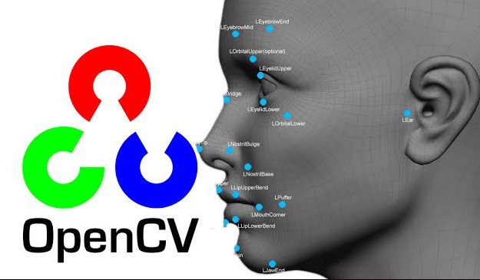
Overview
Open-Source framework for image processing in python & C++.
Can be used to perform tasks like face detection, objection tracking, landmark detection, and much more
OpenCV
Source: https://medium.com/analytics-vidhya/getting-started-on-object-detection-with-opencv-5962a75876a6

Slide 15
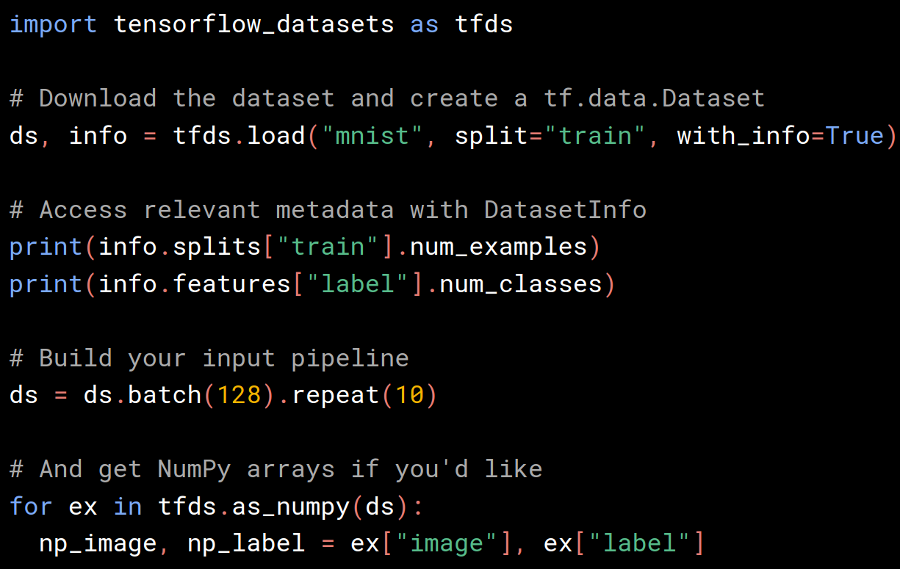
Overview
It is an open-source artificial intelligence library, using data flow graphs to build models
TensorFlow object recognition algorithms classify and identify arbitrary objects within larger images.
Tensorflow

Slide 16
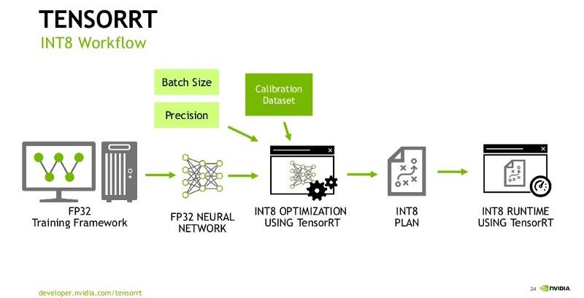
Overview
It an SDK for high-performance deep learning inference
enables the developer to optimize inference leveraging libraries, development tools
TensorRT
Source: https://pylessons.com/YOLOv4-TF2-TensorRT

Slide 17
Thank You

